Slide 1

Customer Shopping Behavior Analysis

Slide 2




Project Overview: Unlocking Insights
Analyzing 3,900 purchases to drive strategic decisions.
Spending Habits
Segmentation
Understand customer expenditure.
Identify distinct customer groups.
Product Preferences
Subscription Trends
Discover popular items.
Analyze recurring revenue.

Slide 3


Dataset at a Glance
3,900 records, 18 features for comprehensive analysis.
Key Attributes
Customer Demographics (Age, Gender, Location, Subscription)
Purchase Information (Item, Category, Amount, Season, Size, Color)
Shopping Behavior (Discount, Promo Code, Previous Purchases, Frequency, Review, Shipping)
Review Rating column: 37 missing values require handling.

Slide 4
Exploratory Data Analysis (EDA) with Python
Preparing, cleaning, and structuring data for reliable insights.
01
02
03
Data Loading
Initial Exploration
Missing Values
Imported dataset using pandas.
Inspected data structure and summary statistics.
Imputed Review Rating using median per category.
04
05
06
Column Standardization
Feature Engineering
Data Consistency
Converted names to snake case for clarity.
Created age_group and purchase_frequency_days.
Removed redundant promo_code_used.
07
Database Integration
Connected to MySQL Workbench for SQL analysis.

Slide 5
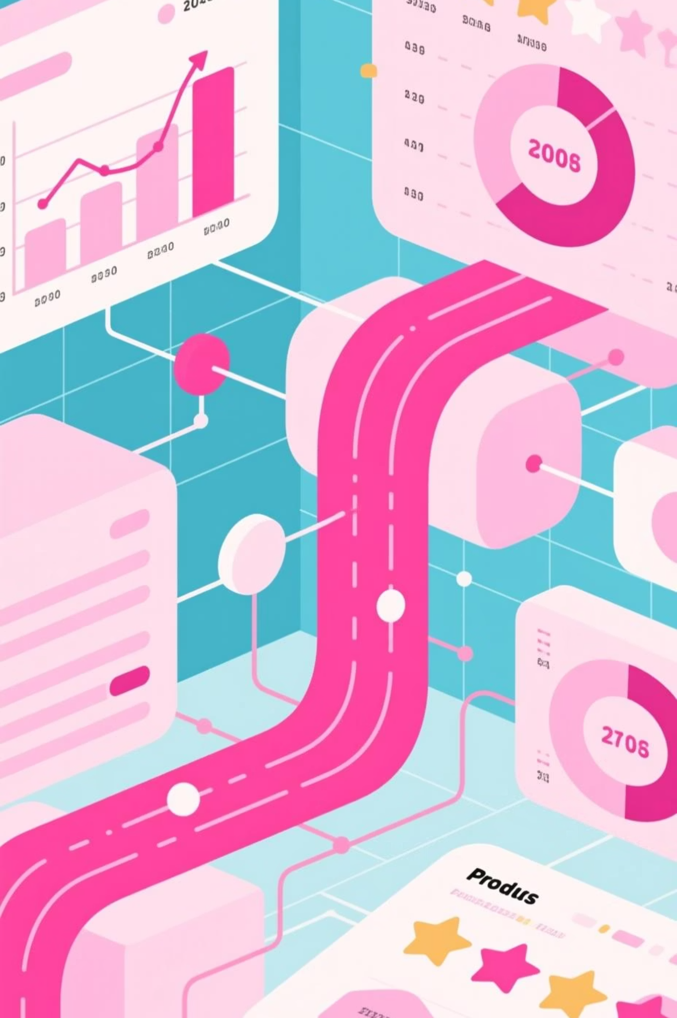
Data Analysis with SQL: Business Transactions
Extracting actionable insights from transactional data.
Revenue by Gender
High-Spending Discount Users
Male: $157,890, Female: $75,191
Customers using discounts, spending above average.
Top 5 Products by Rating
Gloves (3.86), Sandals (3.84), Boots (3.82), Hat (3.8), Skirt (3.78)

Slide 6
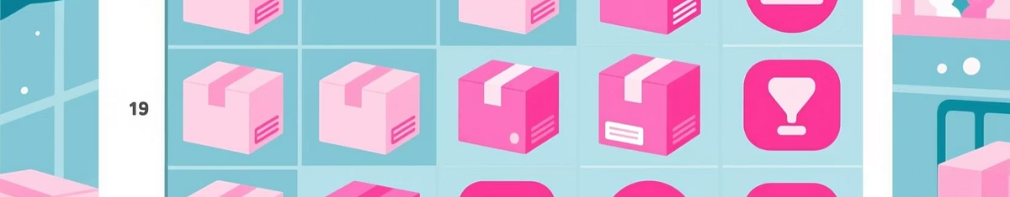
SQL Insights: Shipping & Subscriptions
1
2
3
Shipping Type Comparison
Subscribers vs. Non-Subscribers
Discount-Dependent Products
Express: $60.48 avg. purchase; Standard: $58.46 avg. purchase.
Subscribers: 1053 customers, $59.49 avg. spend. Non-subscribers: 2847 customers, $59.87 avg. spend.
Hat (50%), Sneakers (49.66%), Coat (49.07%), Sweater (48.17%), Pants (47.37%).

Slide 7
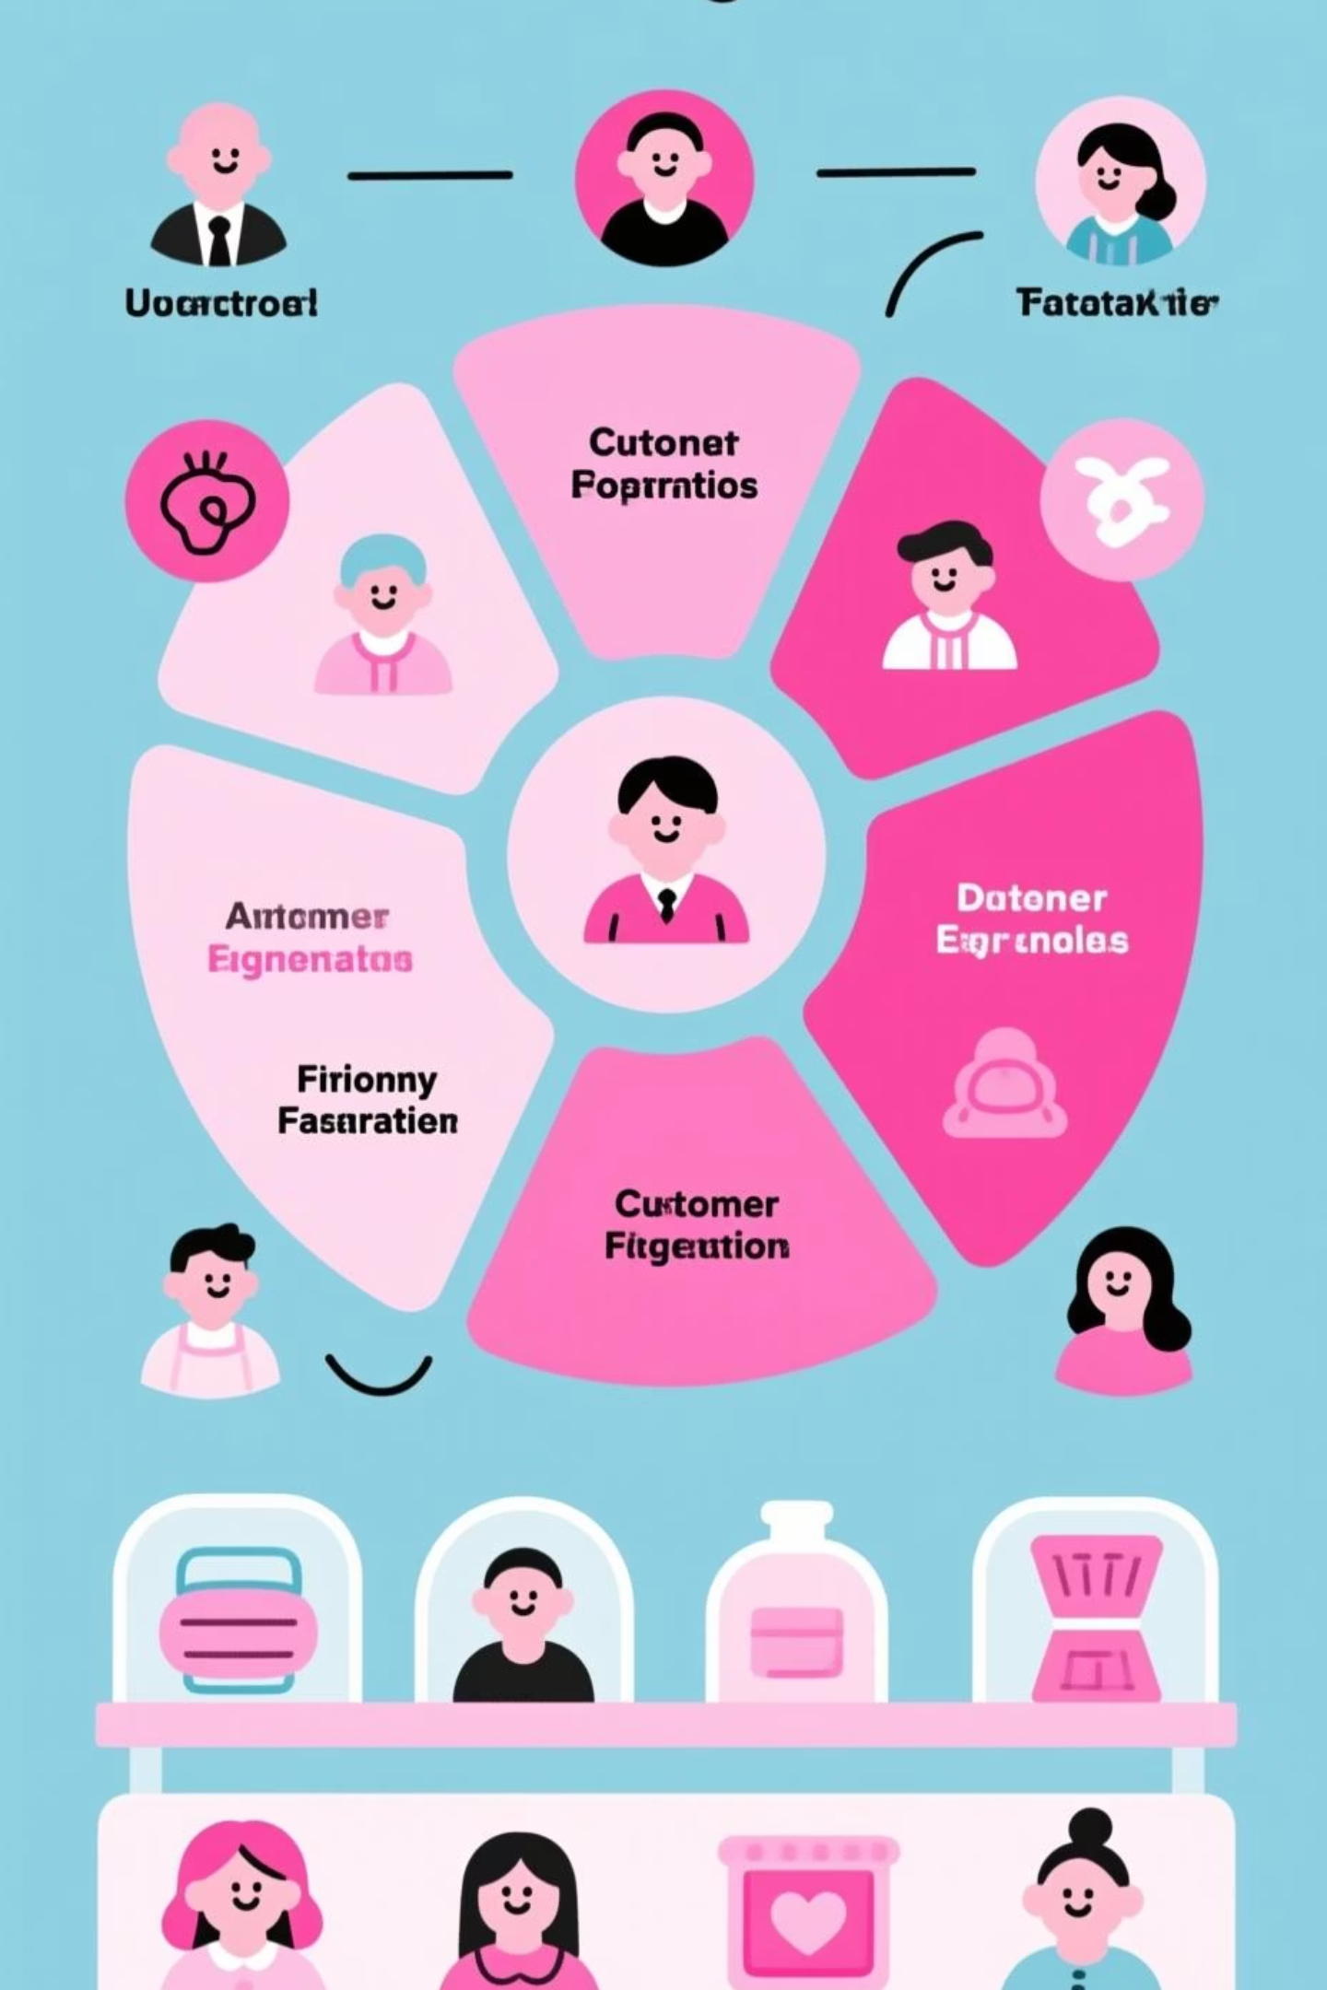
Customer Segmentation & Product Ranking
Customer Segments
Top Products per Category
Accessories: Jewelry, Sunglasses, Belt
Loyal
3116 customers
Clothing: Blouse, Pants, Shirt
Footwear: Sandals, Shoes, Sneakers
Returning
Outerwear: Jacket, Coat
701 customers
New
83 customers

Slide 8
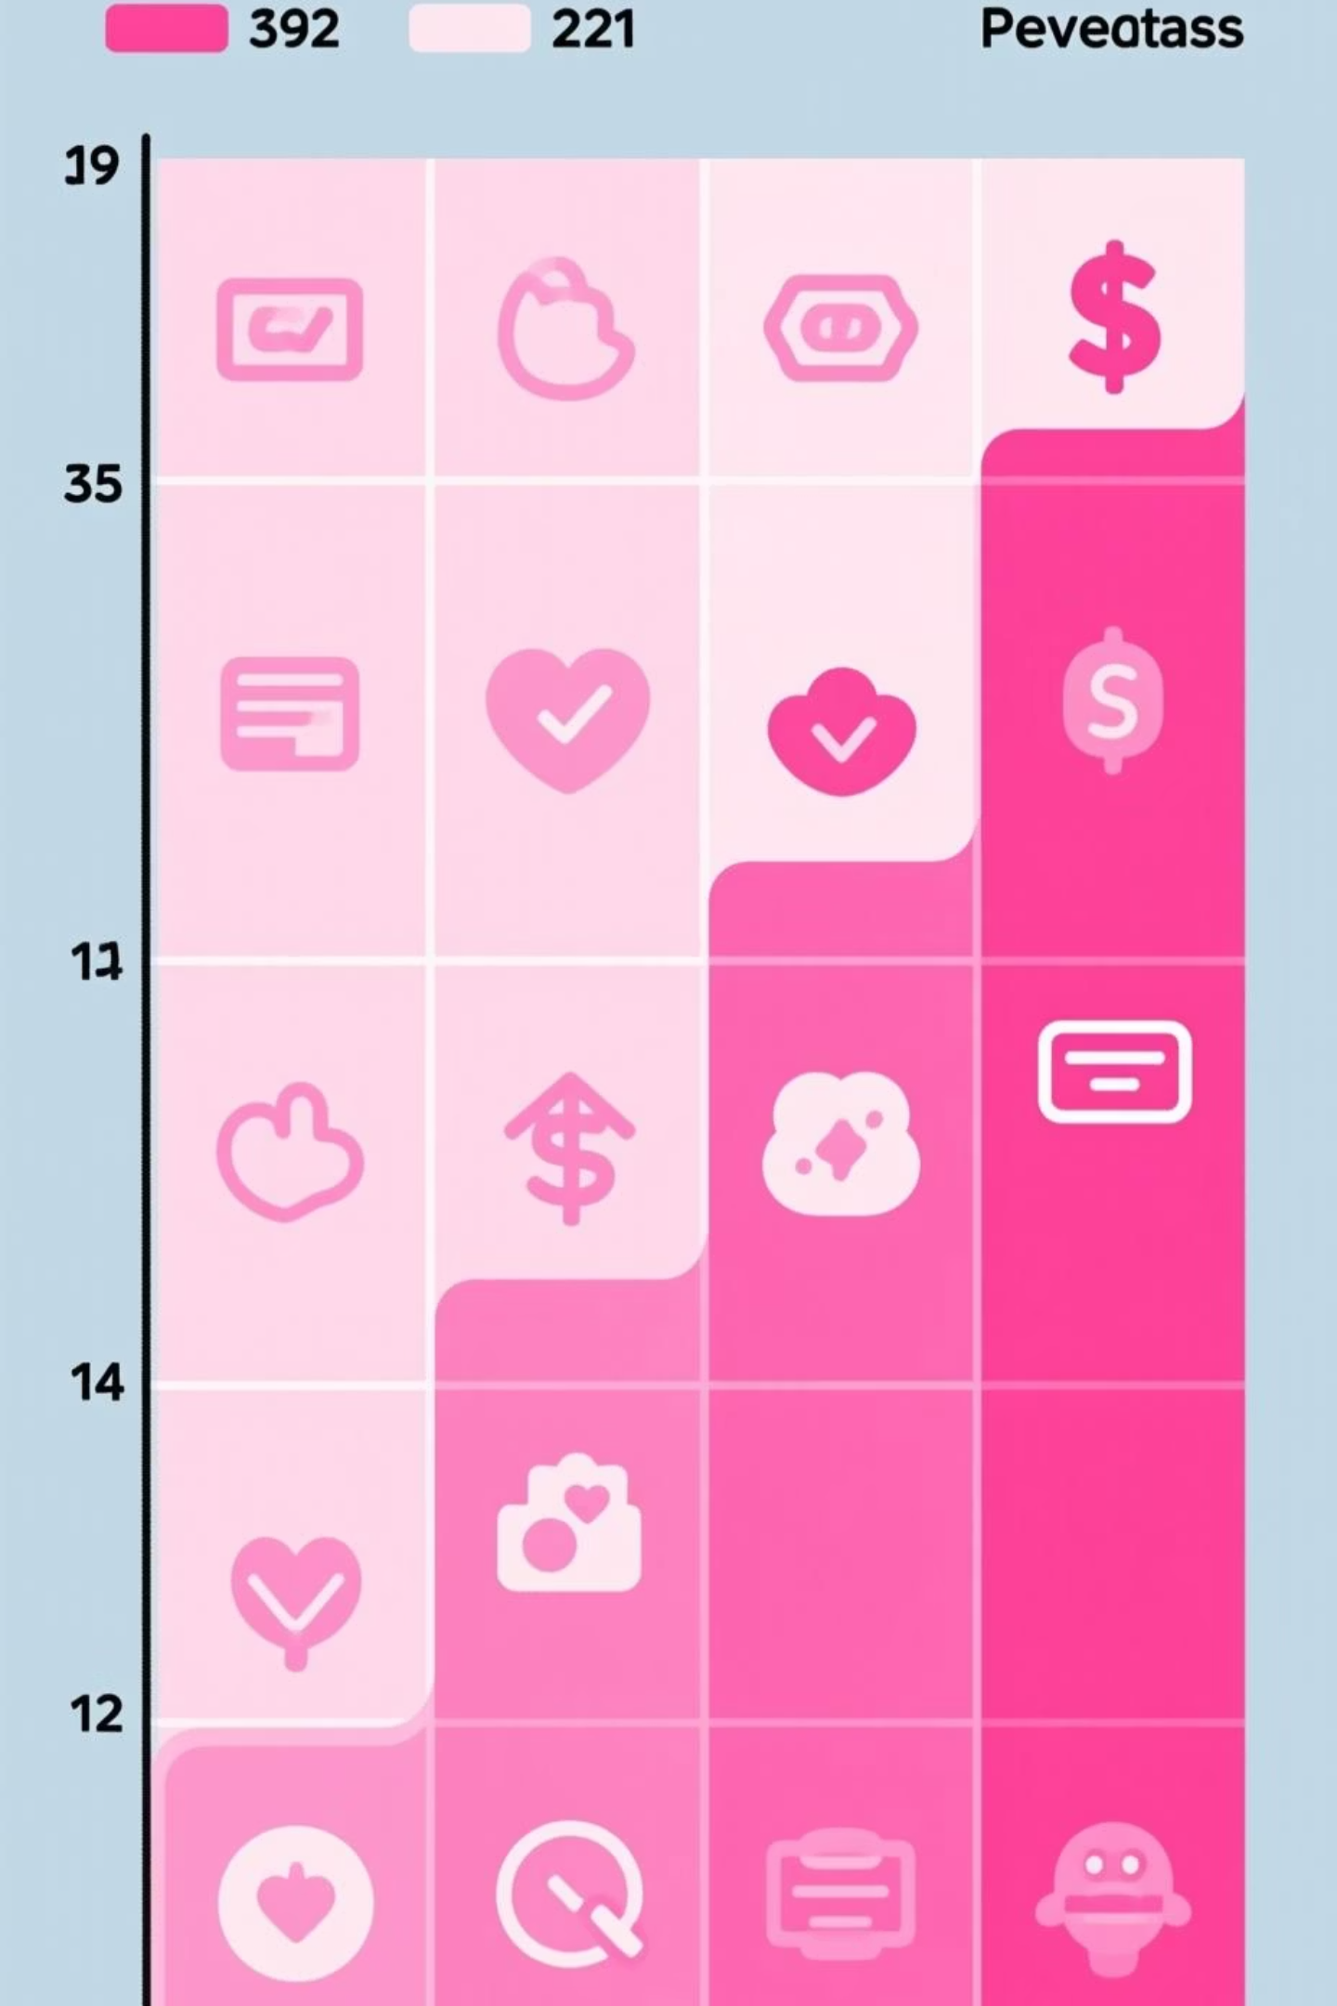
Repeat Buyers & Revenue by Age
Repeat Buyers & Subscriptions
Customers with >5 purchases: 958 subscribed, 2518 not subscribed.
Revenue by Age Group
Young Adult: $62,143
Middle-Aged: $59,197
Adult: $55,978
Senior: $55,763

Slide 9
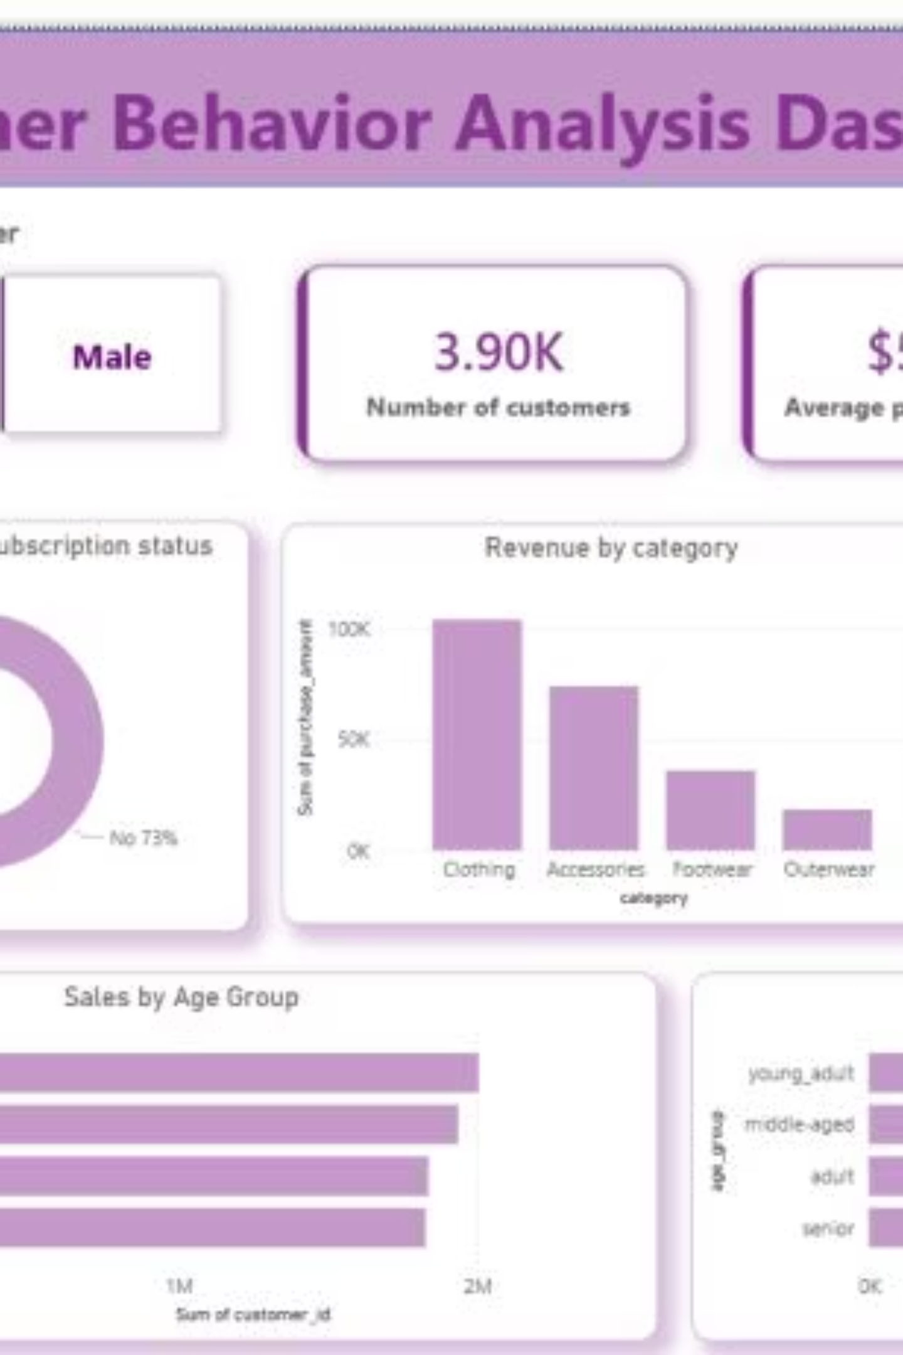
Interactive Dashboard in Power BI
Visualizing key insights for informed decision-making.
3.90K
$59.76
3.75
Customers
Avg. Purchase
Avg. Review

Slide 10


Business Recommendations
Strategies for growth and optimization.
Strengthen Subscription Adoption
Promote exclusive benefits: early access, free express shipping, loyalty points.
Enhance Customer Loyalty Programs
Implement tier-based rewards to incentivize frequent purchases and reduce churn.
Optimize Discount Strategy
Reassess discount-heavy products, target promotions to protect profit margins.
Targeted & Lifecycle-Based Marketing
Personalize campaigns for high-revenue age groups and customer stages.

